Slide 1
Problem Statement:
How can our team conduct a virtual approach to acquire the necessary static and dynamic characteristics to fulfill the custom golf fitting process?

Slide 2

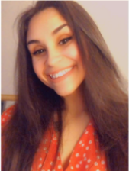
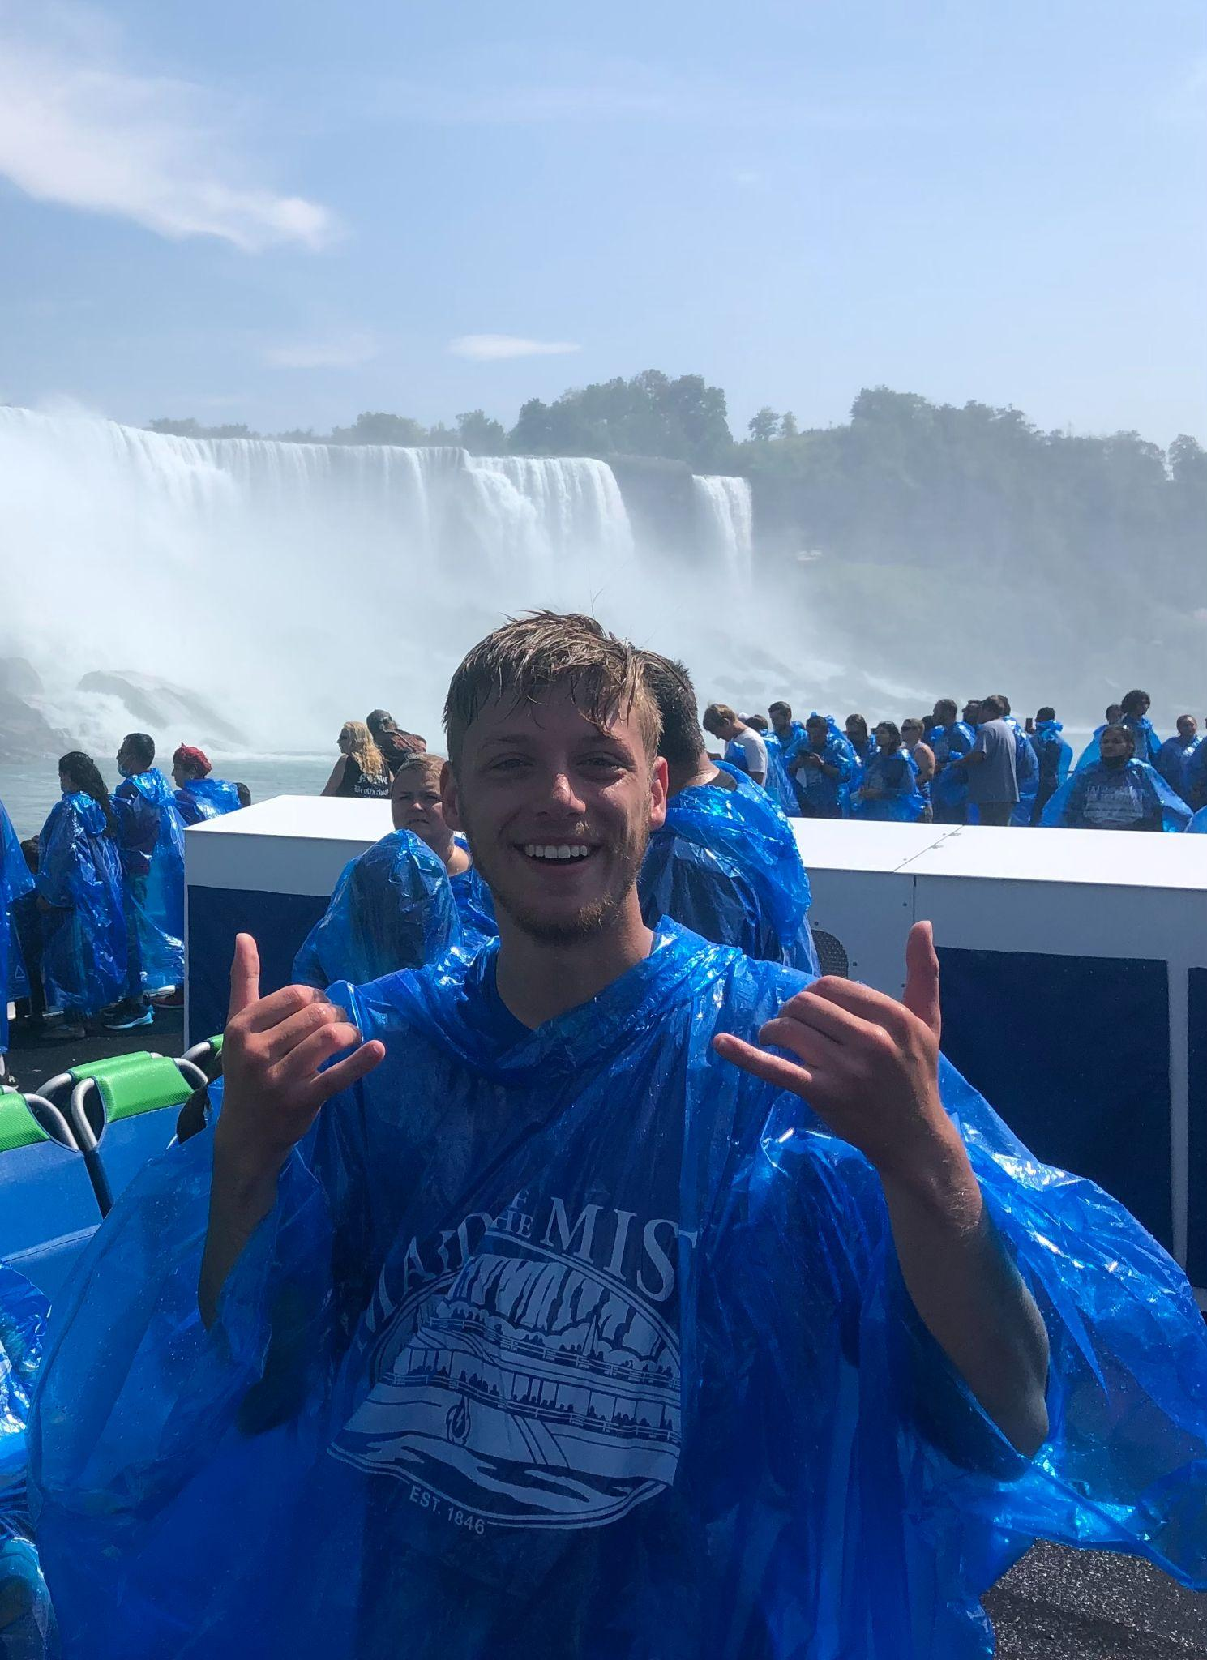


Meet Our Team!
Alan Palayil
Junior in Computer Engineering and Cyber-security
Madelyn Arroyo
Senior in Psychological Science and Human Resources
Jake Westerhoff
Senior in Civil Engineering
Diego Guatemala
Senior in Mechanical Engineering
Yeshwanth Vemula
Junior in Computer Science

Slide 3
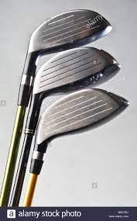
What the Customer Will Be Buying
Three Different Prototype Drivers
Each driver will have a different face angle
The sensor will be included
Shipping & Handling
There will be an option for express delivery

Slide 4
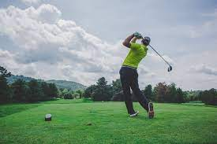
According to the Nation Golf Foundation (NGA),
Every state has seen an increase of at least 2% in golf rounds

Slide 5
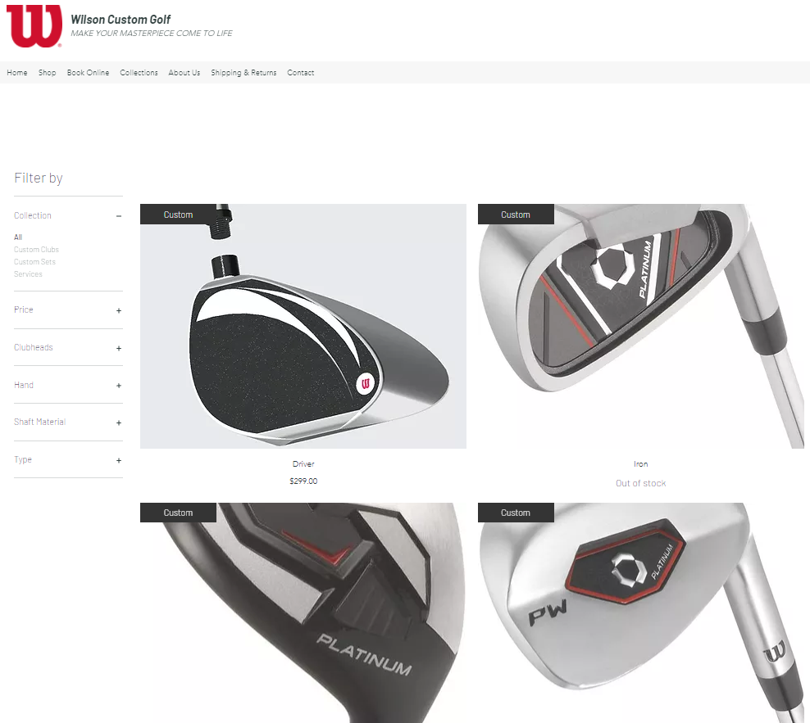
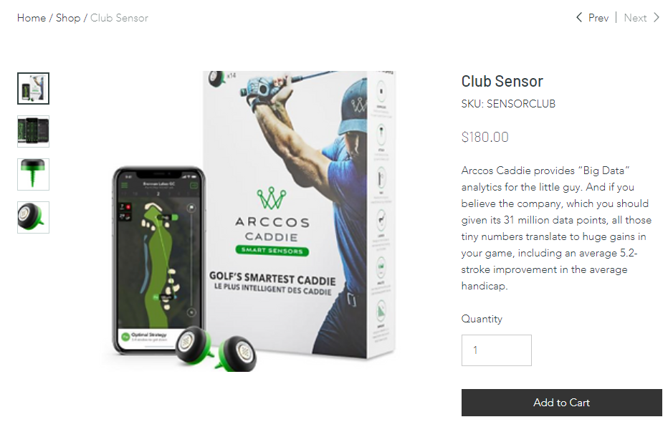
Our Solution:
We developed our own website to advertise wilson golf clubs and to create a profile.
We incorporated the use of the sensor to calculate the needed dynamic data.

Slide 6

Community Partner
Wilson Sports

Slide 8
*Insert Calendar*

Slide 9
Sources
https://www.wikihow.com/Fit-Golf-Clubs
https://truespecgolf.com/blog/2018/09/19/what-is-custom-club-fitting/
https://www.golfpass.com/travel-advisor/articles/club-fitting-101-why-you-should-get-fit-and-what-you-need-to-know
https://practical-golf.com/lie-angle/#:~:text=Afer%20you%20make%20impact%20the,your%20lie%20angle%20is%20correct.
https://www.golfwrx.com/101632/the-most-important-fitting-elements-for-accuracy/
https://www.macworld.com/article/225800/arccos-golf-review-club-sensors-and-ios-app-can-pinpoint-where-your-golf-game-needs-work.html

Slide 10

Thank you

